Slide 1
GC 16 | Introduction to DBMS
Manikandan.C

Slide 2
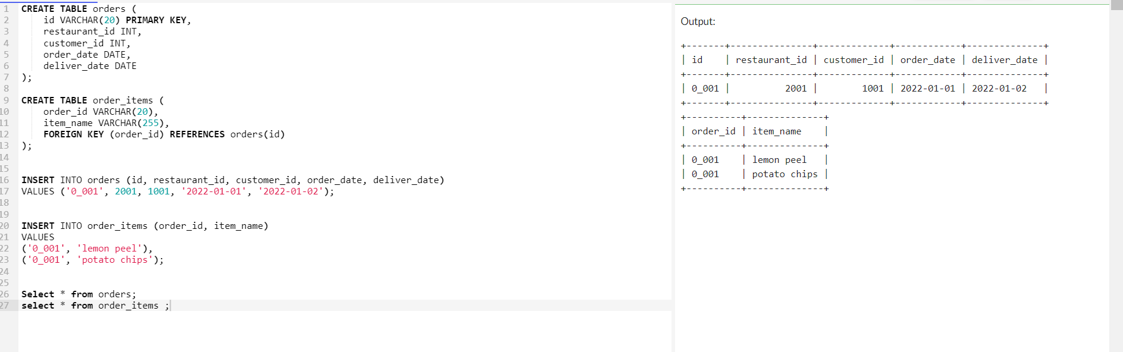
Insert Order Entries

Slide 3
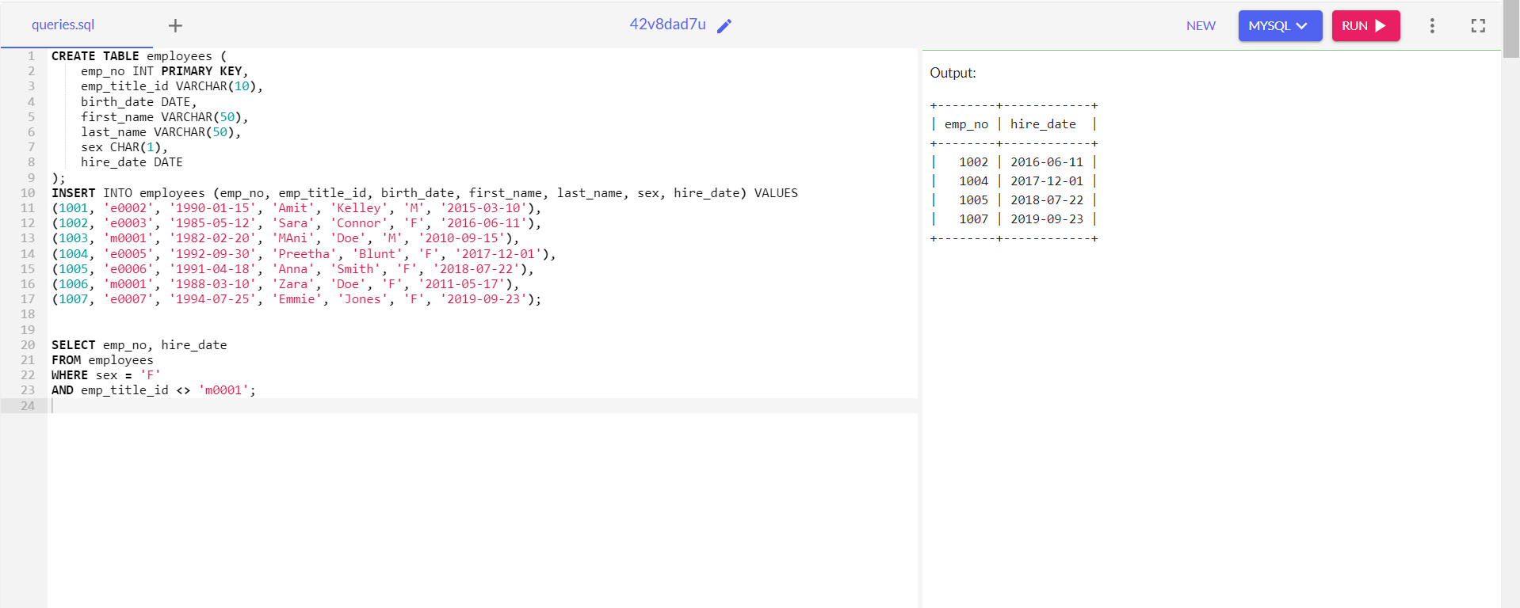
List of Employee Number and Title

Slide 4
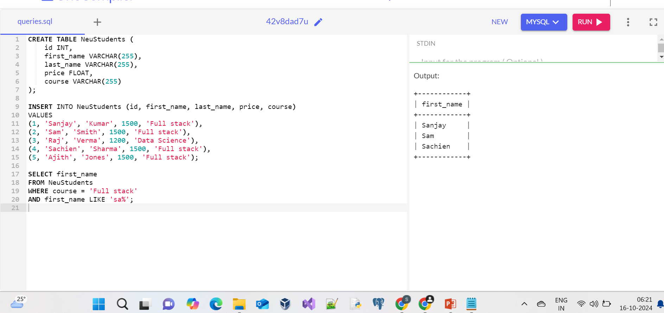
First Name of Student

Slide 5
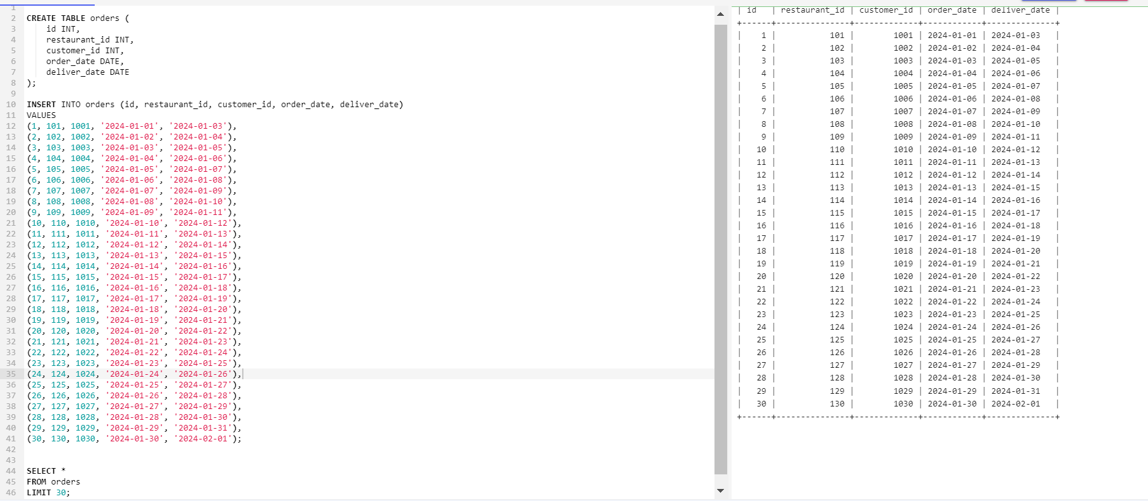
First thirty rows

Slide 6
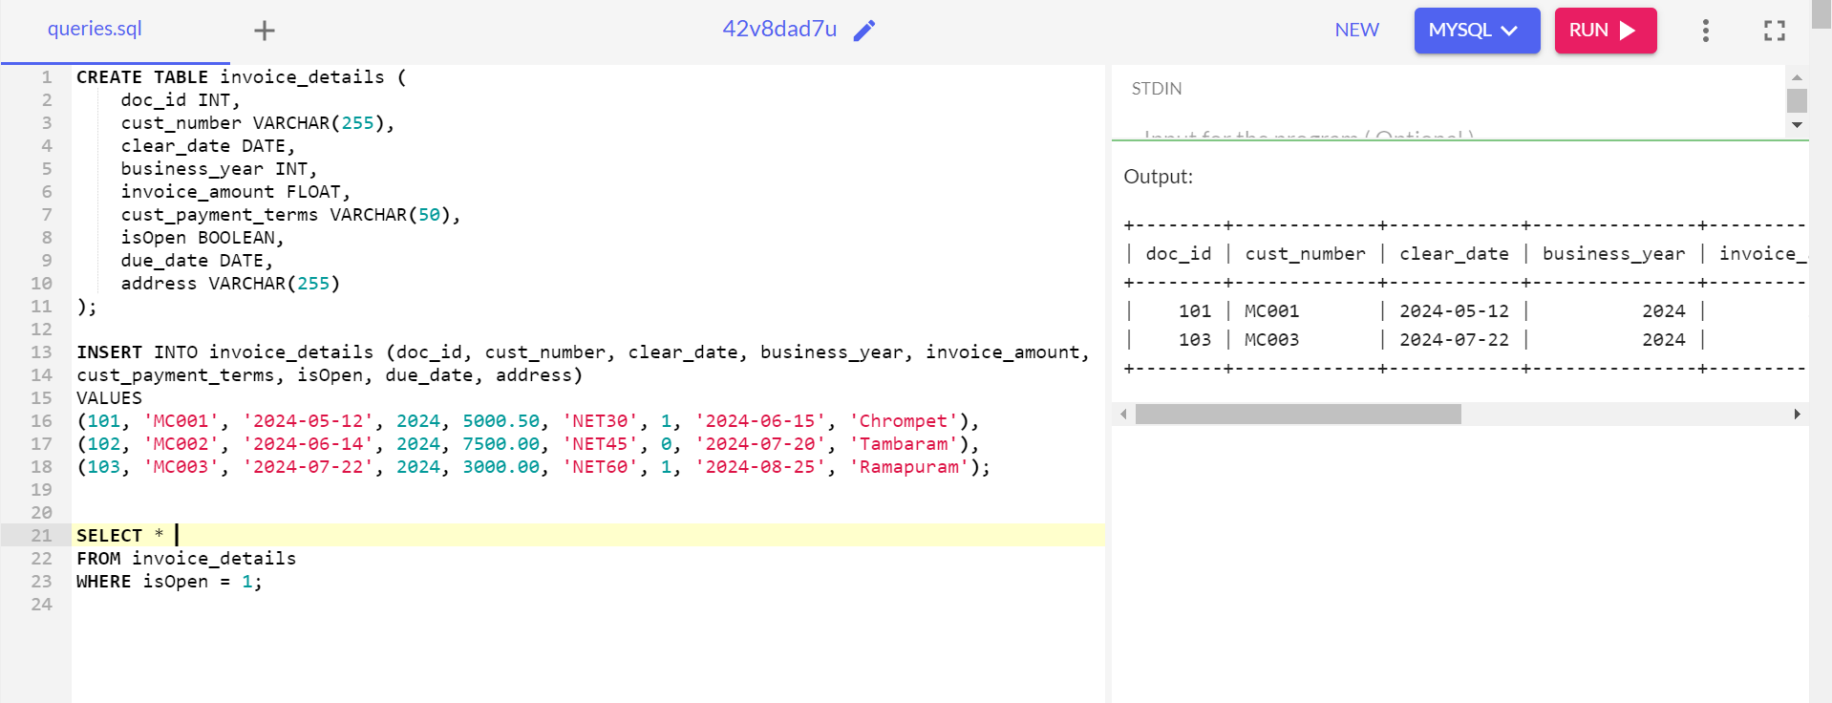
Display open invoices

